Slide 1
Introduction to blockchain
Distributed Ledger Technology
Concepts and Opportunities
Christophe Demangeot
Technology Consultant
Blockchain Evangelist
Chained by Design Founder
christophe@chainedbydesign.digital
#ChainedByDesign

Slide 2

About Trust and Risk
Our trust values have changed:
  Government and Financial Institutions
  Technology - The internet, our data, our identity
  Our interactions with strangers (AirBnb, Uber)
Lack of trust leads to risk based evaluations:
  Is my data safe, secure, reliable, timely and accurate?
  Where is my identity stored? How is it being used? Who can access it?
  Which 3rd party can I use to ensure trust?
  How do I know my business partners are doing the right thing?
christophe@chainedbydesign.digital
#ChainedByDesign

Slide 3

The Diamond story
christophe@chainedbydesign.digital
#ChainedByDesign

Slide 4

History of blockchain
Cryptographically secured chain of blocks was described in 1991
The first blockchain was conceptualised in 2008
  Implemented in 2009 as a core component of the digital currency Bitcoin
  Designed by Satoshi Nakamoto
By 2014, Ethereum introduced Smart Contract: Blockchain-based programmes that can be partially or fully executed or enforced without human interaction
Yet, many challenges are yet to be overcome
  Legal, governance, technical, performance, tooling
“Blockchain is to Business what the Internet was to Communication”
“Blockchain is the court of law of the Internet”
christophe@chainedbydesign.digital
#ChainedByDesign

Slide 5
The blockchain promise
Blockchain concepts:
  Cryptography - Secure communication in the presence of adversaries
  Distributed ledger – Every node has a complete copy of the entire ledger
  Peer to peer network – no central point of failure
  Tamper-proof storage – Chain of blocks
  Permissioned access – Controls who can do and see what
Blockchain promises:
  Immutable ledger – high quality data and process integrity
  Consensus driven approach – a majority of nodes must agree
  Trust-less consortium – Trusted technology
  Ecosystem simplification – Faster & cheaper transactions with no 3rd party
christophe@chainedbydesign.digital
#ChainedByDesign

Slide 6
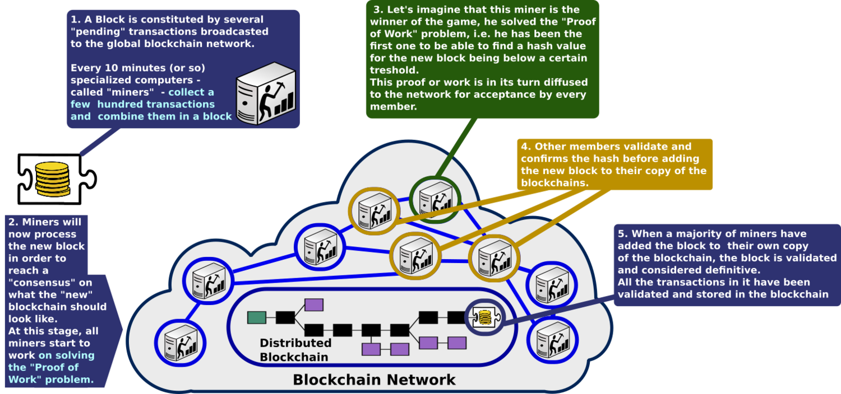
Blockchain flow
christophe@chainedbydesign.digital
#ChainedByDesign

Slide 7
Common use cases
Blockchain is a Distributed Ledger Technology
  It’s all about transactions
Supply chain and contract management
Voting – the “double spend” problem
Identity management
  Confidential patient records – Official documents – Public identity
Alternative currencies
  A growing list of digital / crypto currencies already available
IoT for automatic trigger to smart contracts
The ICO phenomenon for simplified funding
christophe@chainedbydesign.digital
#ChainedByDesign

Slide 8
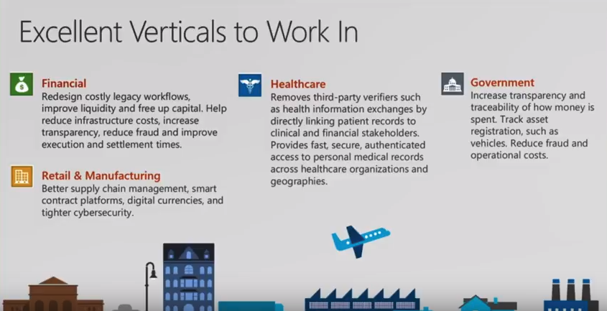
Opportunities
When should you to consider blockchain? When…
You do not trust other parties
Transaction costs are too high
You want to exchange digital assets / digital value tokens
You need to control and protect your identity / intellectual property
You need governance through consensus
christophe@chainedbydesign.digital
#ChainedByDesign

Slide 9
Recommended approach
F.I.T.S. model review
Objective: Business case and high level strategy
Build the PoC and evaluate
Objective: PoC outcomes and detailed strategy
Fine tune the PoC and deployment
Objective: Go live
Create a Tiger Team
Build a PoC
Industrialisation of the PoC
Build the Blockchain Strategy
Develop your blockchain strategy for the next 2/3 years
Team of blockchain specialists
(Strategy, Technology, Governance & Legal)
christophe@chainedbydesign.digital
#ChainedByDesign

Slide 10
Any questions?
According to a recent survey conducted by IBM and the Economic Intelligence Unit, government interest in blockchain is high:
9 in 10 government organizations plan to invest in blockchain for use in financial transaction management, asset management, contract management and regulatory compliance by 2018
7 in 10 government executives predict blockchain will significantly disrupt the area of contract management
14 percent of government organizations expect to have blockchains in production and at scale in 2017
Contact: christophe@chainedbydesign.digital
christophe@chainedbydesign.digital
#ChainedByDesign

Slide 11
References
White Paper: Bitcoin
Overview: IBM Think Academy: Blockchain, How it works
Overview: Understanding Blockchain – Westpac
Overview: What is blockchain?
7 Ways Blockchain Can Stop Climate Change & Save The Environment
Technical Overview: Blockchain 101 - A Visual Demo
Ethererum: DEVCON1: Ethereum for Dummies - Dr. Gavin Wood
Development: Ethererum for Windows set up
Development: 101 Smart Contract with Ethereum
YouTube: Best blockchain videos with EpiCenter
christophe@chainedbydesign.digital
#ChainedByDesign

